Slide 1
2Market Analysis
File created on: 1/3/24 12:32:06 PM PST

Slide 2
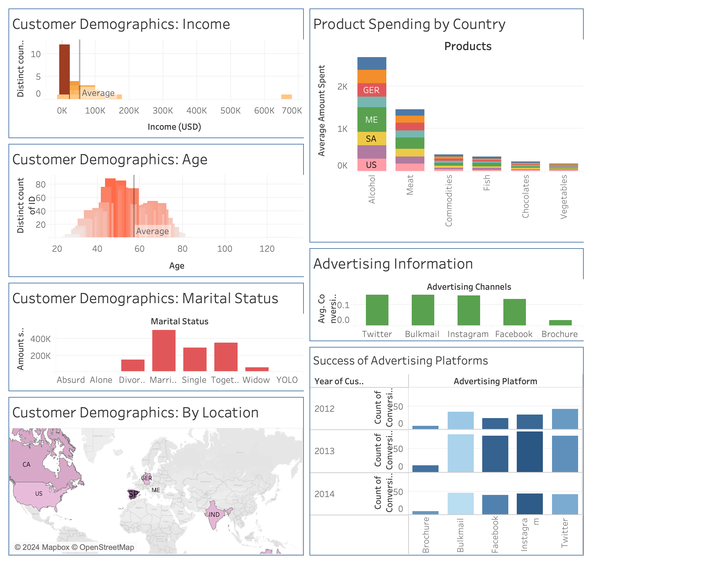

Slide 3
